Slide 1
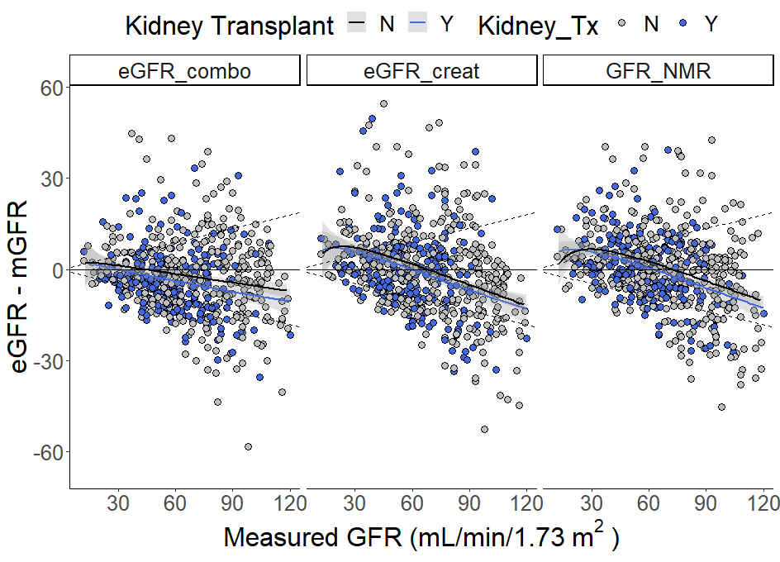
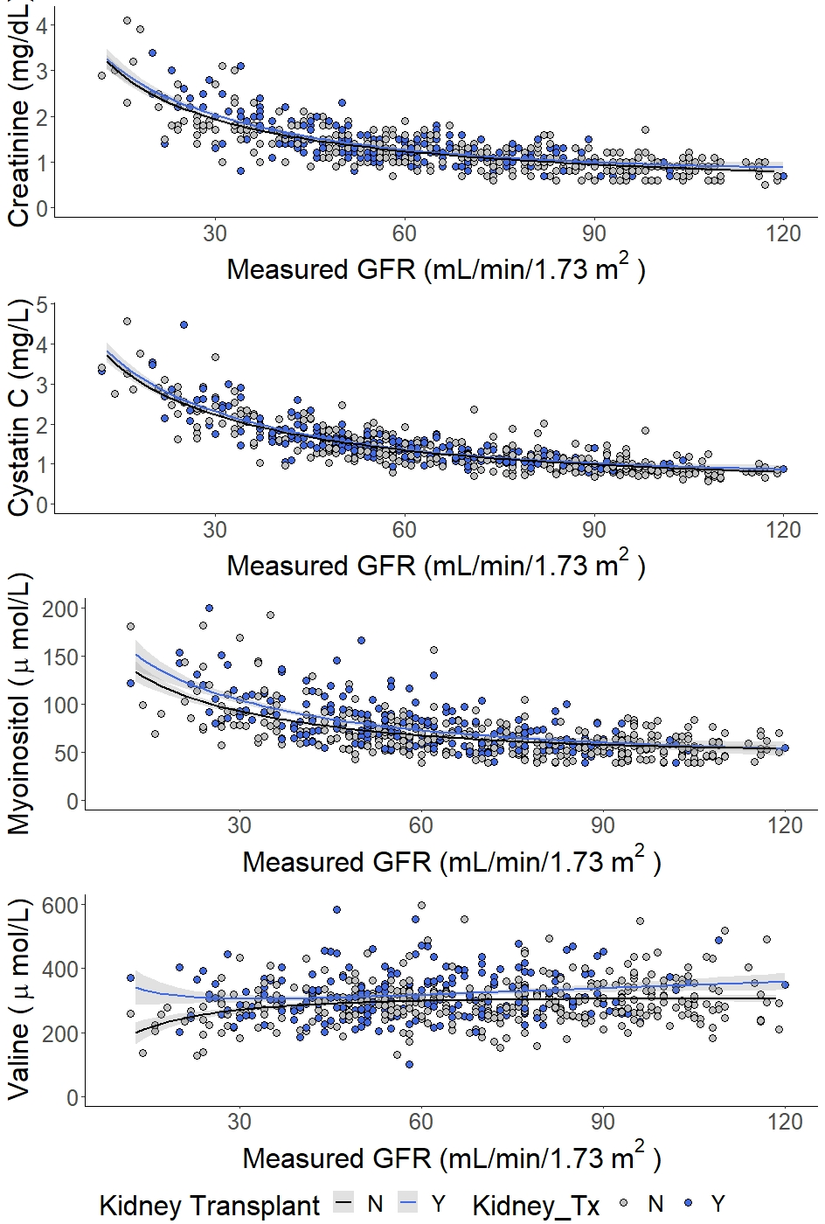
Performance of a novel race-Independent GFR estimating equation in kidney transplant recipients based upon NMR-measured
Jeffrey W. Meeusen,¹ Surendra Dasari,¹ John C. Lieske,¹ Marcello Grassi,² Frank Stämmler, ² Eric Schiffer²
¹Department of Laboratory Medicin and Pathology, Mayo Clinic, Rochester, MN; ²Numares AG, Regensburg, Germany
Introduction
Objectives
RESULTS
Figure 2
DISCUSSION
Close monitoring of glomerular filtration rate (GFR) is essential for the management of patients post kidney transplantation.
Measured GFR (mGFR), the gold standard, is not readily accessible in most centers.
The performance of 2021 estimated GFR (eGFR) equations based on creatinine & cystatin C have not been evaluated in kidney transplant patients.
Evaluate the 2021 CKD-EPI eGFR methods compared to iothalamate GFR in a group of patients with and without kidney transplant.
Determine the performance of NMR-metabolomics based eGFR methods compared to measured GFR and CKD-EPI equations.
Kidney transplant recipients accounted for 220 (37%) participants (Table 1).
Kidney transplant recipients showed no difference in age, sex or BMI (Table 1).
Serum myo-inositol increased with decreased mGFR.(Figure 1).
Compared to mGFR, there was no significant bias for eGFRcr or eGFR_{NMR}, while eGFRcr-cys significantly underestimated mGFR (Table 2).
P15 was significantly higher for eGFR_{NMR} compared to eGFRcr among all patients (Figure 2).
P15 was higher for eGFRcr-cys only among patients without a kidney transplant.
Agreement with mGFR CKD was identical for eGFRcr and eGFRcr-cys (61.8%, both cases) while eGFR_{NMR} was significantly higher (66.4%) among patients with a kidney transplant. (Table 2)
Addition of serum valine and myo-inositol along with creatinine and cystatin C (eGFR_{NMR}) improved the P15 and concordance compared to eGFRcr and eGFRcr-cys.
Previous studies have reported associations between kidney failure and increases in both myo-inositol and valine. Altered inositol metabolism following kidney transplantation and among patients taking calcineurin inhibitors commonly prescribed for immunosuppression following solid organ transplant are also reported.
More study is required on the potentially confounding interactions between reduced kidney function, transplantation, immunosuppression and serum metabolites.
Table 1
 | Kidney Transplant | Kidney Transplant | No Kidney Transplant | No Kidney Transplant | p-value
N (%) | 220 | 220 | 382 | 382
Age, y | 55±14 | 55±14 | 57±13 | 57±13 | n.s.
Female, n (%) | 97 (44%) | 97 (44%) | 170 (44%) | 170 (44%) | n.s.
BMI, kg/m² | 30±6.1 | 30±6.1 | 29±5.9 | 29±5.9 | n.s.
Diabetes, n (%) | 88 (40%) | 88 (40%) | 70 (18%) | 70 (18%) | <0.01
Hypertension, n (%) | 199 (90%) | 199 (90%) | 144 (38%) | 144 (38%) | <0.001
Organ Transplant (not Kidney), n (%) | 38 (17%) | 38 (17%) | 113 (29%) | 113 (29%) | <0.01
Measured GFR | 59±20 | 59±20 | 74±30 | 74±30 | <0.01
Measured GFR group
<15 mL/min/1.73m² | 1 (0.5%) |  | 3 (0.8%) |  | n.s.
15-29 mL/min/1.73m² | 16 (7.3%) |  | 25 (6.5%) |  | n.s.
30 to 44 mL/min/1.73m² | 43 (19.5%) |  | 37 (9.7%) |  | <0.01
45 to 59 mL/min/1.73m² | 62 (28.2%) |  | 74 (19.4%) |  | 0.01
60 to 89 mL/min/1.73m² | 86 (39.1%) |  | 126 (33.0%) |  | n.s.
≥90 mL/min/1.73m² | 12 (5.5%) |  | 117 (30.6%) |  | <0.01
Creatinine, mg/dL | 1.40±0.49 |  | 1.21±0.57 |  | <0.01
Cystatin C, mg/L | 1.53±0.55 |  | 1.31±0.62 |  | <0.01
Myo-inositol, µmol/L | 78.3±25.5 |  | 68.0±03.3 |  | <0.01
Valine, µmol/L | 318±71 |  | 298±75 |  | <0.01
METHODS
Figure 1
Table 2
Study Cohort
All patient data was accessed in compliance with the Mayo Clinic Institutional Review Board. Residual sera was obtained from clinical orders for measured GFR (n=602).
Exclusion criteria: chemotherapy, paraplegic, quadriplegic, post amputation, or <18 y of age.
GFR Measurement
GFR was measured by iothalamate clearance (non-radiolabeled). Patients were asked to report fasting but well hydrated. Following subcutaneous iothalamate administration oral hydration was continued and urine and plasma were collected in timed intervals. Iothalamate was quantified by liquid chromatography-tandem mass spectrometry. Body surface area was estimated by the DuBois formula and used to normalize GFR to 1.73m².
GFR Estimation
GFR was estimated using the 2021CKD-EPI creatinine (eGFRcr) and creatinine-cystatin C (eGFRcr-cys) equations or by eGFR_{NMR} which uses serum creatinine, valine and myo-inositol measured by NMR spectroscopy and cystatin C measured by immunoassay.
 | eGFR_{cr} | eGFR_{cr-cys} | p-value* | eGFR_{NMR} | p-value*
Bias: Median Difference; mL/min/1.73m² (95% CI)
Kidney Transplant | -0.05 (-1.67 to 1.36) | -3.84 (-4.83 to -2.51) | <0.01 | 0.412 (-1.30 to 1.68) | 0.82
No Kidney Transplant | -2.17 (-3.53 to -0.829) | -3.57 (-4.72 to -1.89) | 0.04 | -0.12 (-1.34 to 1.17) | 0.96
P₁₅; % (95% CI)
Kidney Transplant | 57.3 (50.7 to 63.8) | 60.9 (54.5 to 67.4) | 0.43 | 67.3 (61.1 to 73.5) | 0.03
No Kidney Transplant | 48.7 (42.1 to 55.3) | 56.0 (49.5 to 62.6) | 0.04 | 58.6 (52.1 to 65.1) | 0.005
P₃₀; % (95% CI)
Kidney Transplant | 85.0 (80.3 to 89.7) | 90.0 (86 to 94) | 0.11 | 90.9 (87.1 to 94.7) | 0.06
No Kidney Transplant | 84.8 (81.2 to 88.4) | 86.9 (83.5 to 90.3) | 0.41 | 85.3 (81.8 to 88.9) | 0.84
Agreement; % (95% CI)
Kidney Transplant | 61.8 (55.4 to 68.2) | 61.8 (55.4 to 68.2) | 1.0 | 66.4 (60.1 to 72.6) | 0.04
No Kidney Transplant | 58.6 (53.7 to 63.6) | 61.8 (56.9 to 66.7) | 0.04 | 60.7 (55.8 to 65.6) | 0.55
CONCLUSIONS
2021 CKD-EPI eGFRcr and eGFRcr-cys have similar bias, P15, and agreement
eGFR_{NMR} more closely matched mGFR
eGFR_{NMR} improvement was most significant among kidney transplant recipients
Multi-marker eGFR improve over creatinine alone and eGFR_{NMR} improves over eGFRcr-cys.
Figure legend odiste idendi delecullam delecte earci omnis est.
FIGURE 3/ 2 LINE HEADER
REFERENCES
Ehrich J, et al. Serum Myo-Inositol, Dimethyl Sulfone, and Valine in Combination with Creatinine Allow Accurate Assessment of Renal Insufficiency-a Proof of Concept. Diagnostics (Basel) (2021) 11(2).
Stammler F, et al. Estimating Glomerular Filtration Rate from Serum Myo-Inositol, Valine, Creatinine and Cystatin C. Diagnostics (Basel) (2021) 11(12).
Fuhrmann M, et al. Analytical Validation of Gfrnmr: A Blood-Based Multiple Biomarker Assay for Accurate Estimation of Glomerular Filtration Rate. Diagnostics (Basel) (2022) 12(5).

